Slide 1
Project – 04 Geophysical tool response
Josh Bell / Luis Cardenas

Slide 2
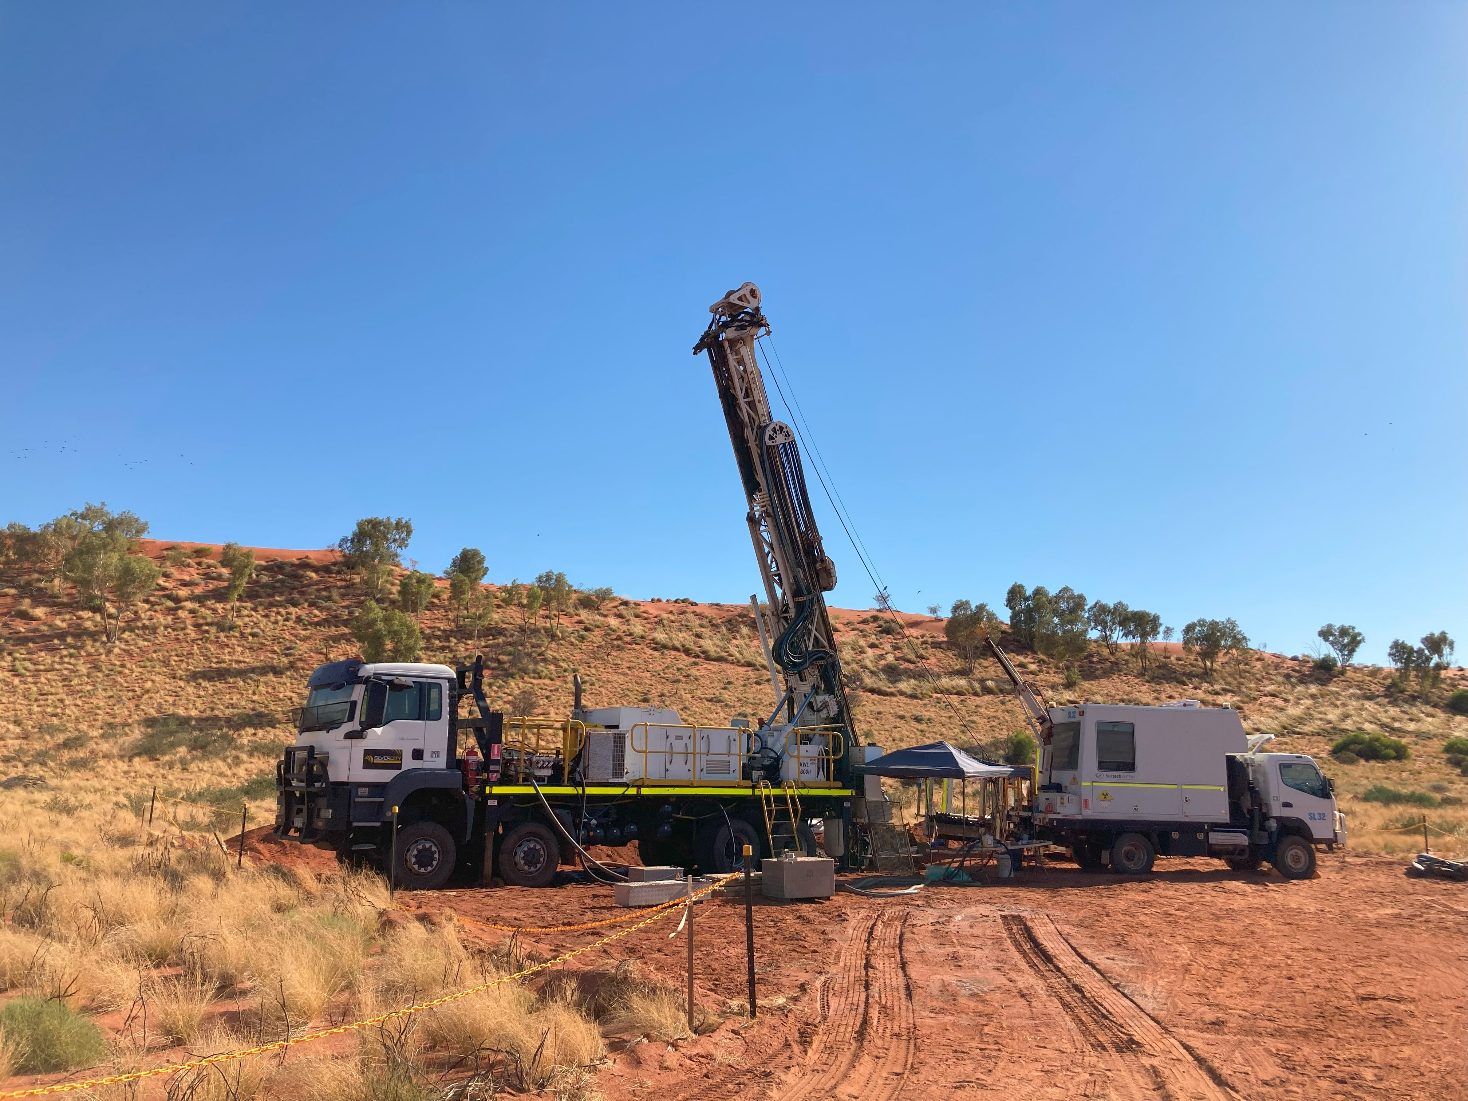
background
Geophysical data plays a crucial role in the mining industry for various reasons.
It aids in target identification, exploration efficiency, resource assessment, environmental considerations, mine planning and monitoring, and cost reduction.
It also significantly contributes to informed decision-making, maximising the chances of success of operations while minimising risks and environmental impacts.
To obtain and acquire the data, personnel must use electronic tools that provide information from drilled holes.

Slide 3
PROBLEM
Geophysical information can be gathered with logging tools run in drilled holes.
General idea
The stability of the drilled holes can degrade over time, and it is imperative to know whether the acquired data is accurate for further analysis and to make correct decisions.
Field situation
May be inexperienced
May acquire information that is not accurate and not realise
When this is identified, the hole might not be accessible anymore
Operators in the field
Provide personnel in the field with aid to know whether the data acquired is valid or whether they should contact an expert to evaluate the data or run another survey with a different tool
action plan

Slide 4
Proposed solution
internal information
Gather information from different locations taken with geophysical tools and analyse it. Reach out to a services company to request access to the information
DATA integration
Perform the ETL process to be able to consolidate and visualise relevant data
Priority action plan
Based on the visualisation of the data, create a model to aid personnel gain confidence in the acquired data promptly

Slide 5
Project OVERVIEW

Slide 6
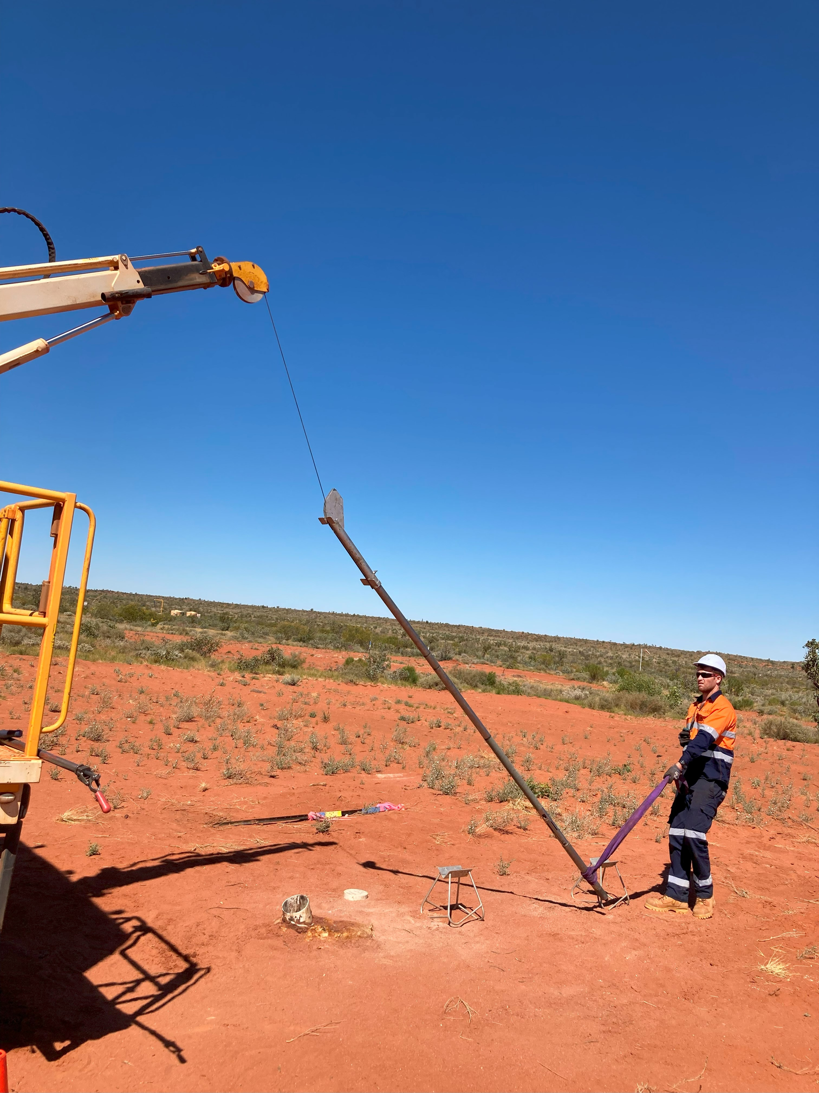
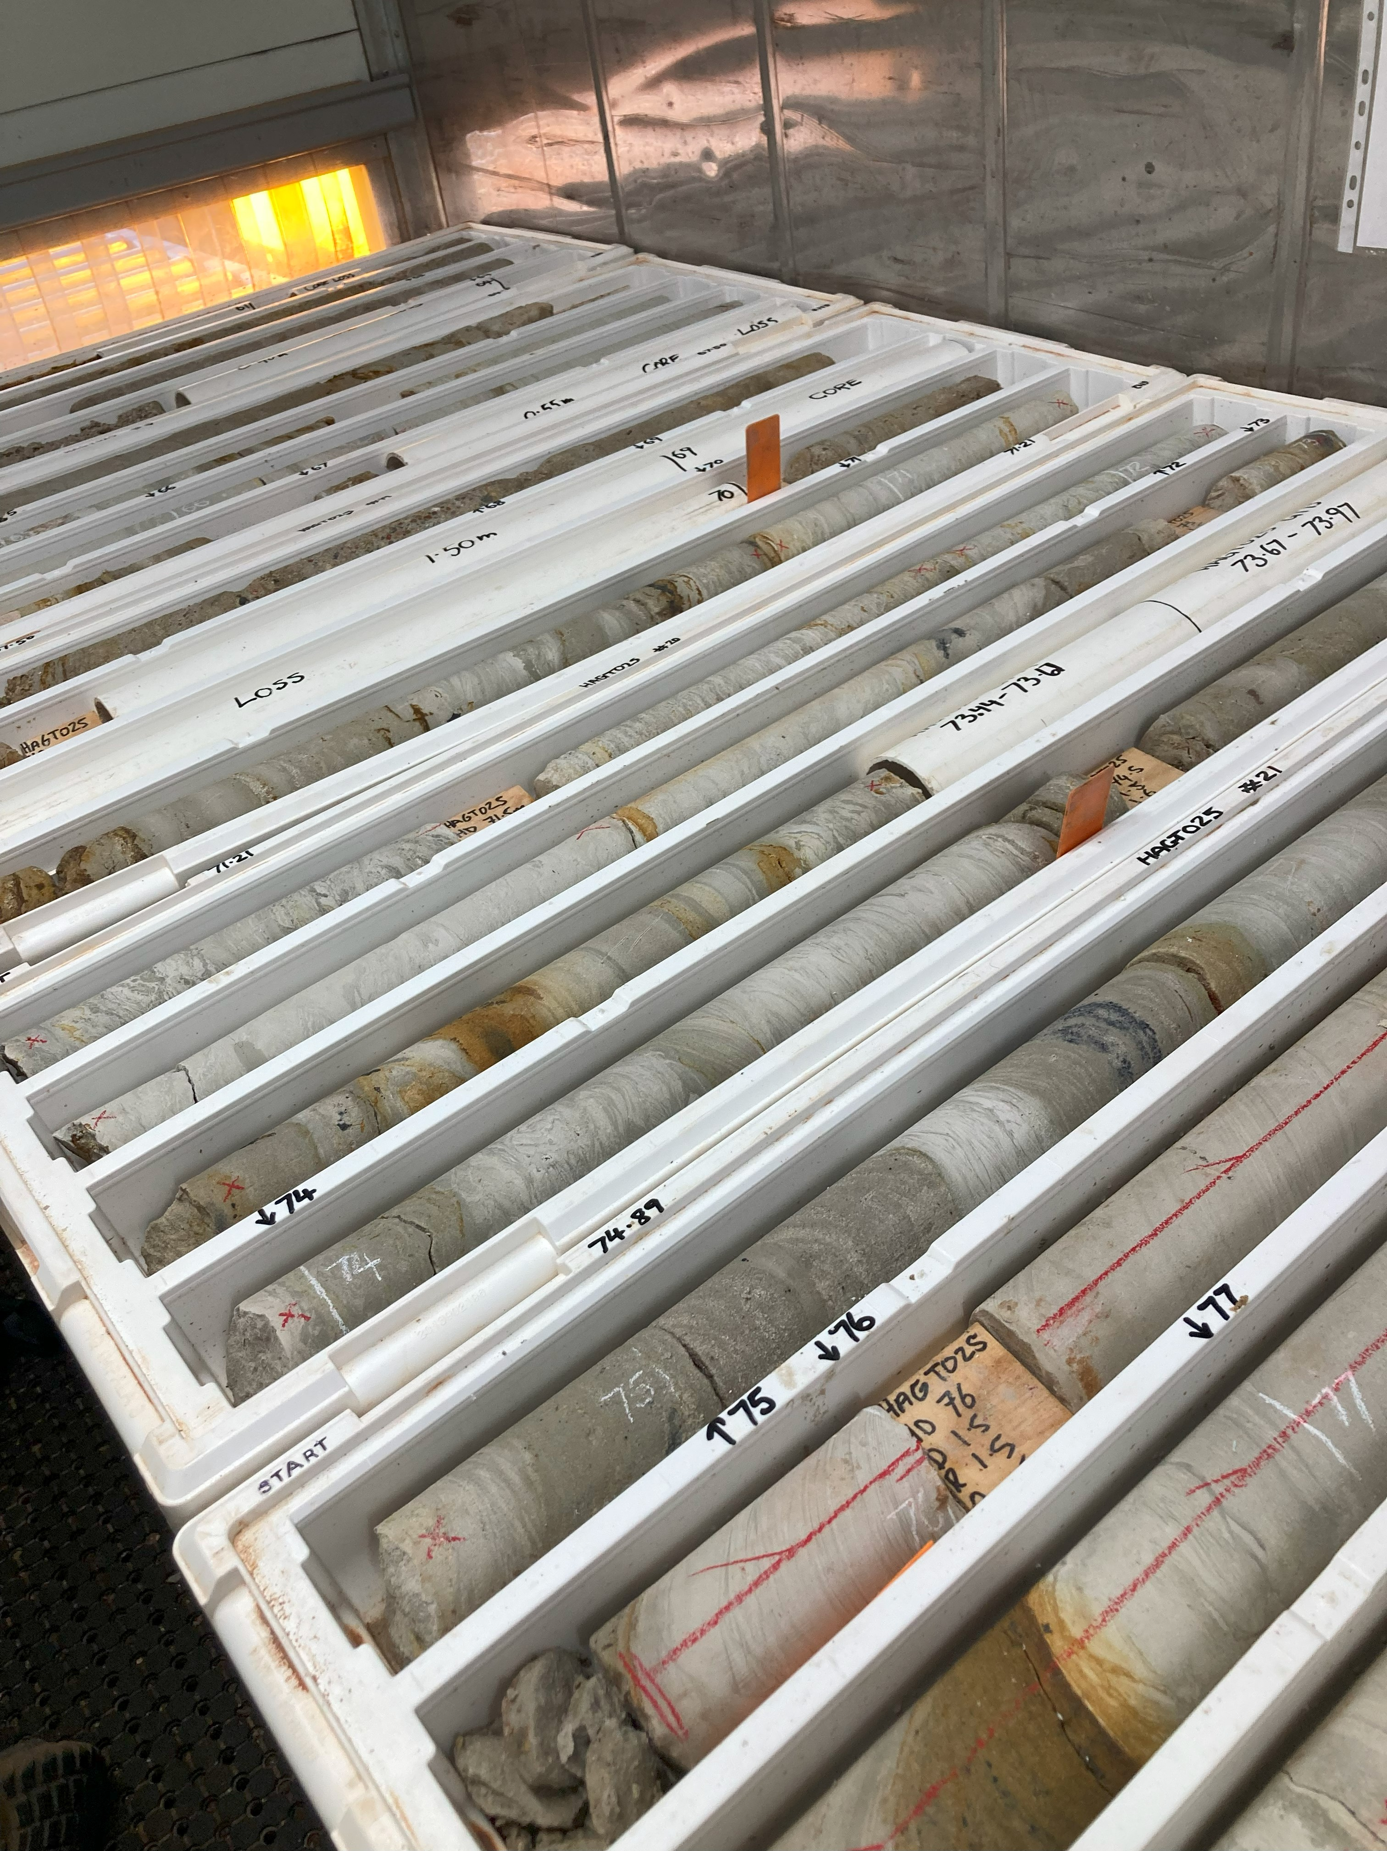
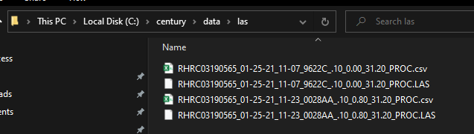
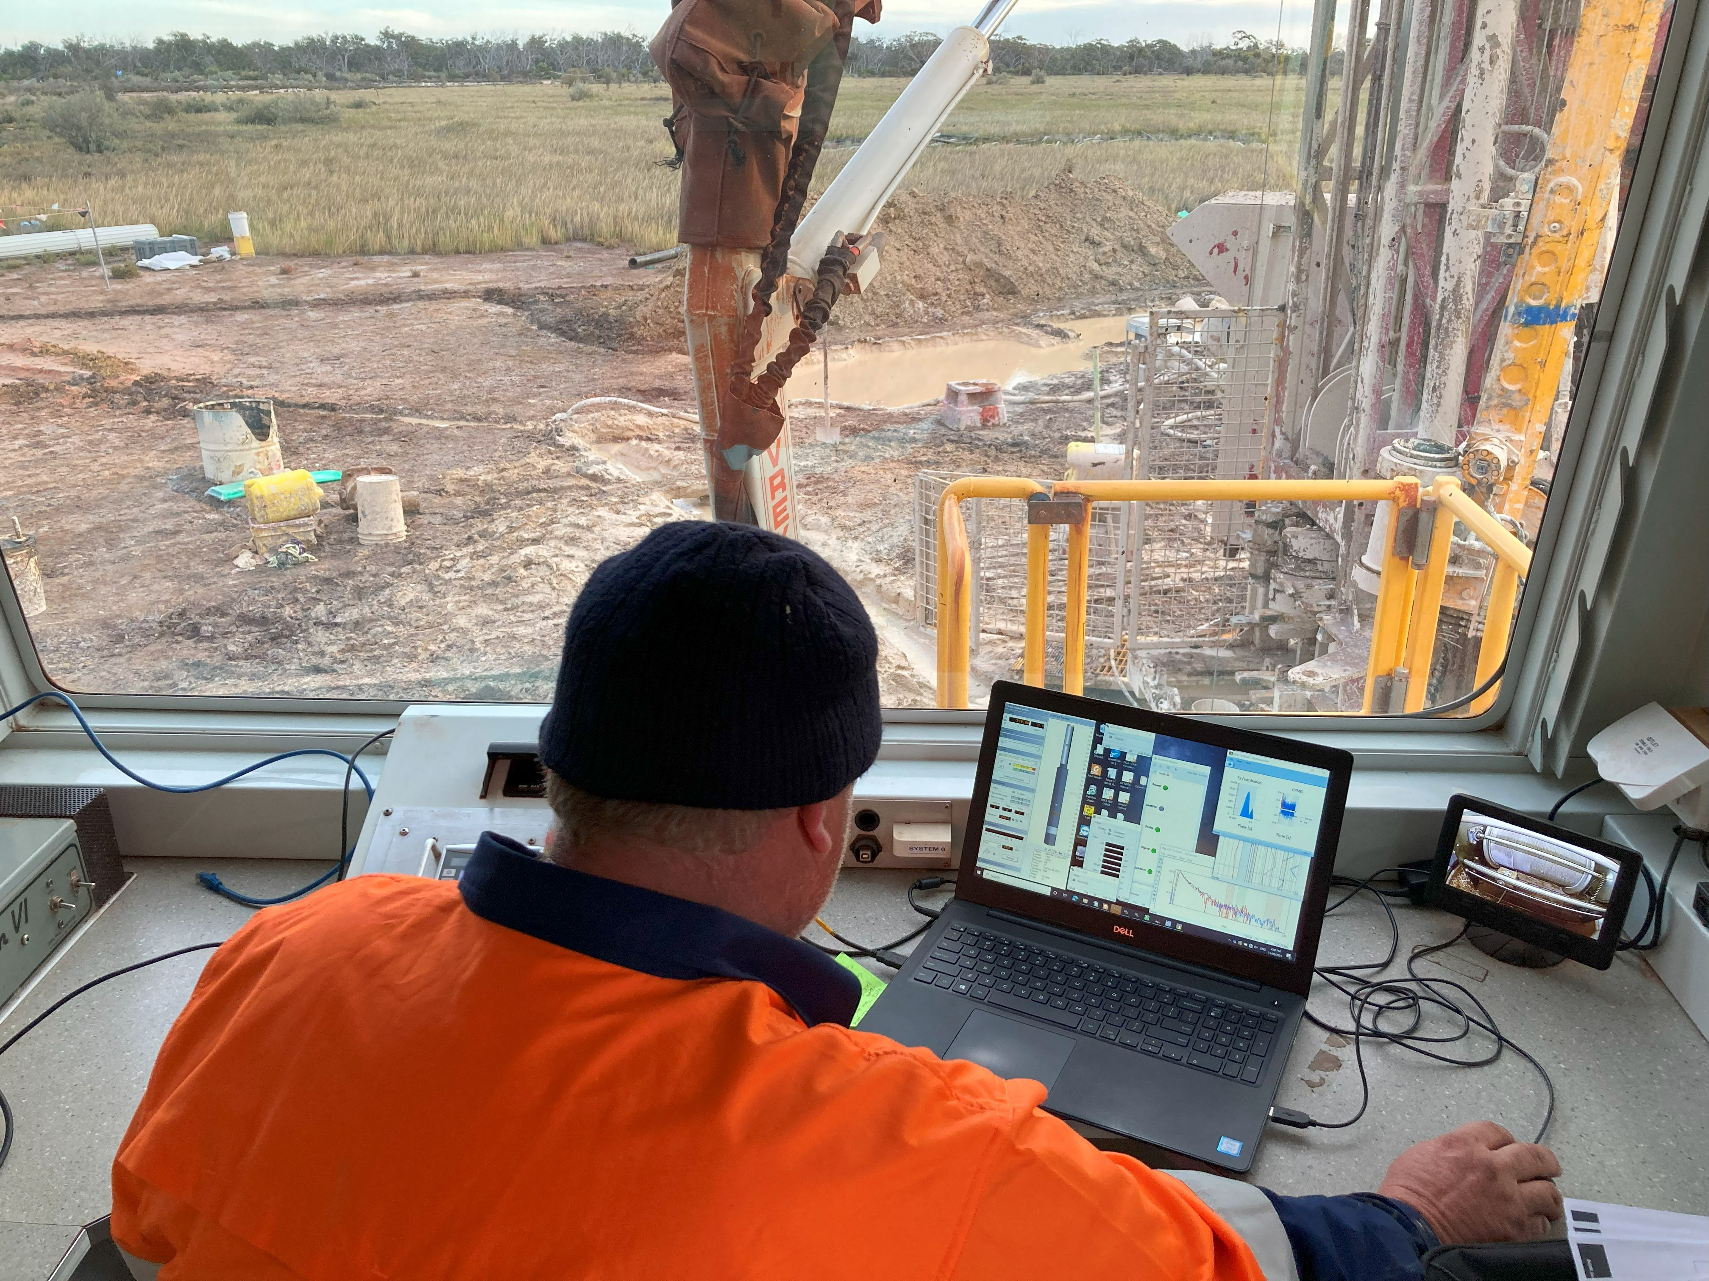
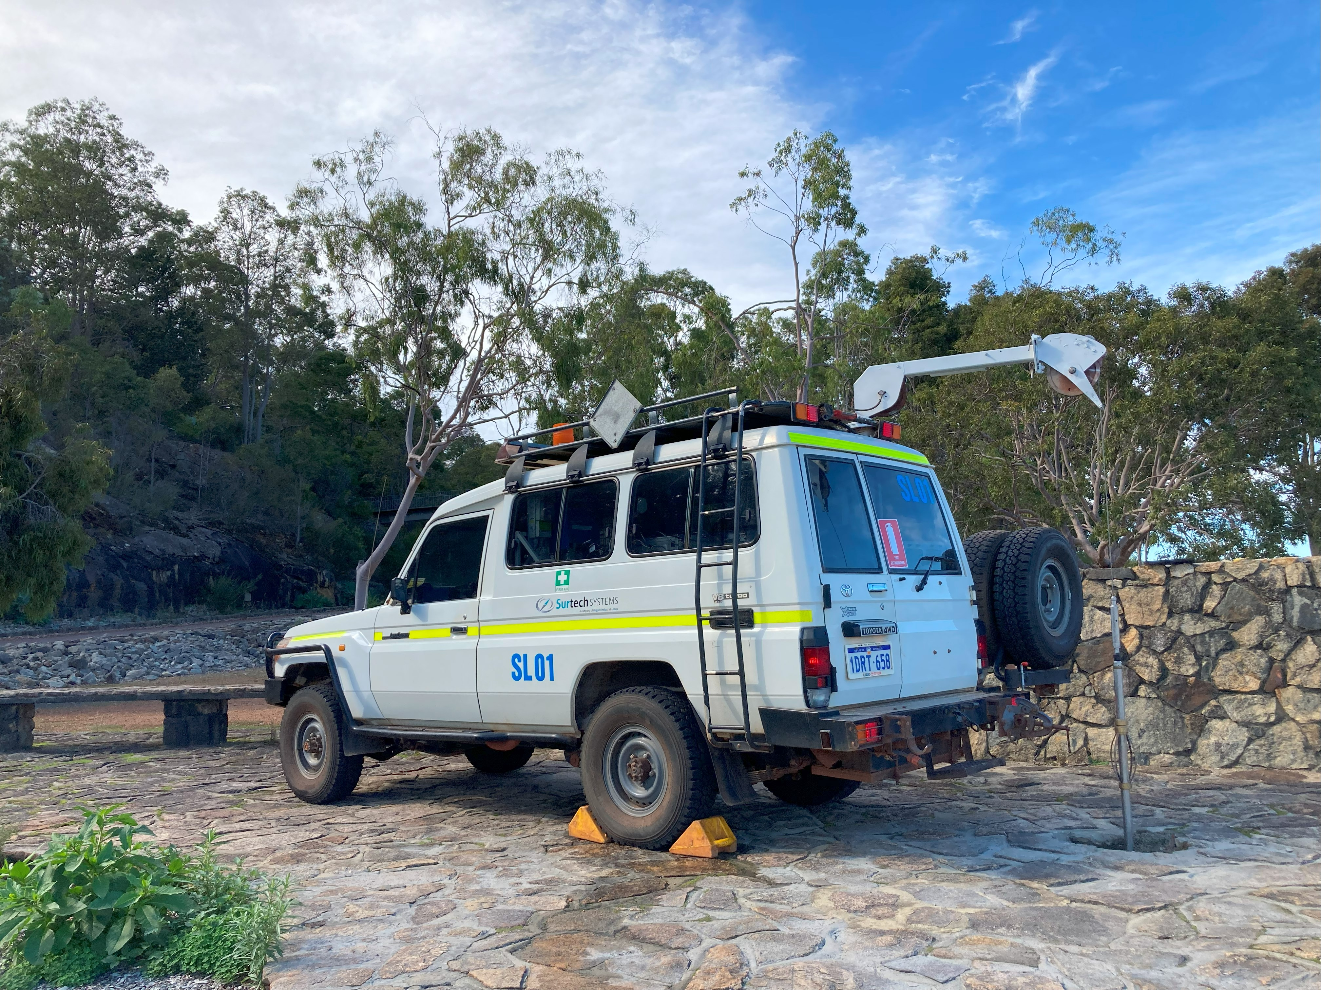
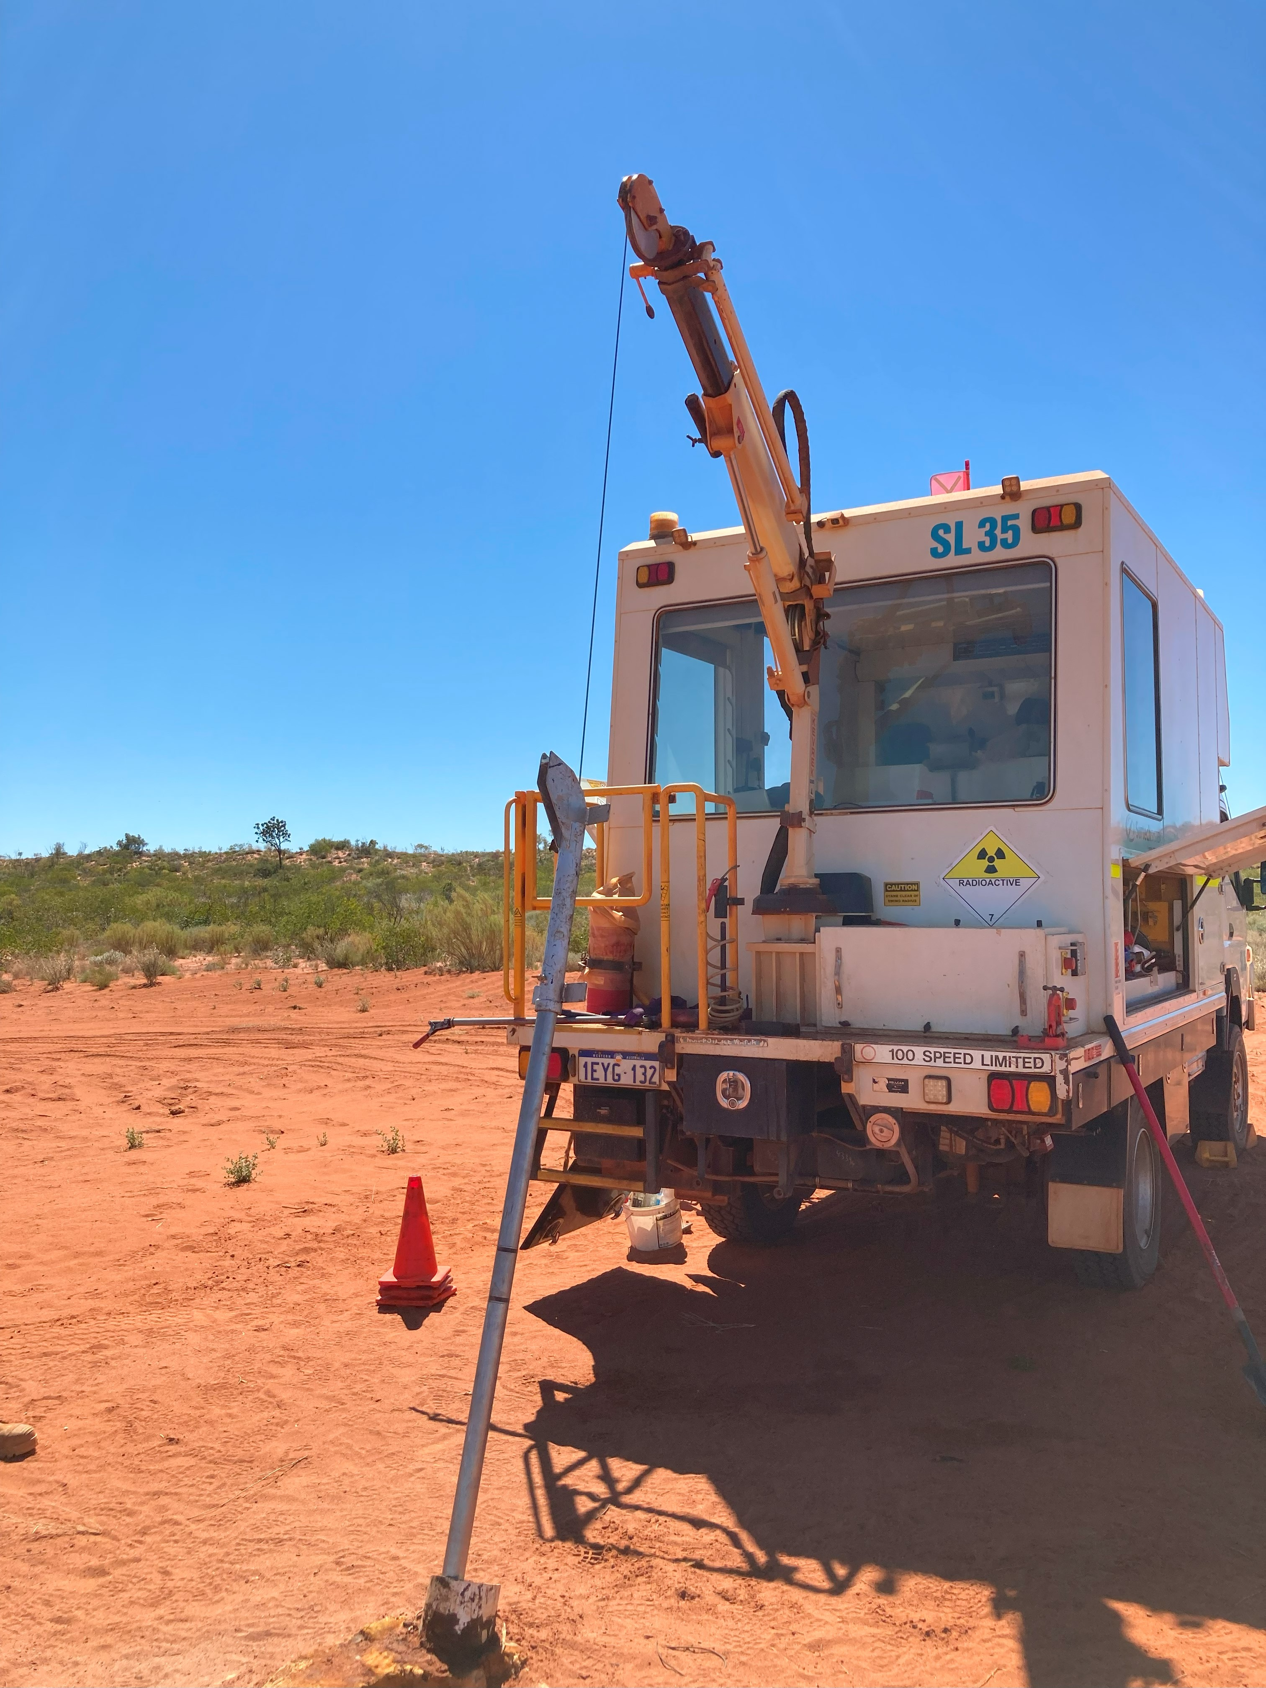
Gathering data

Slide 7
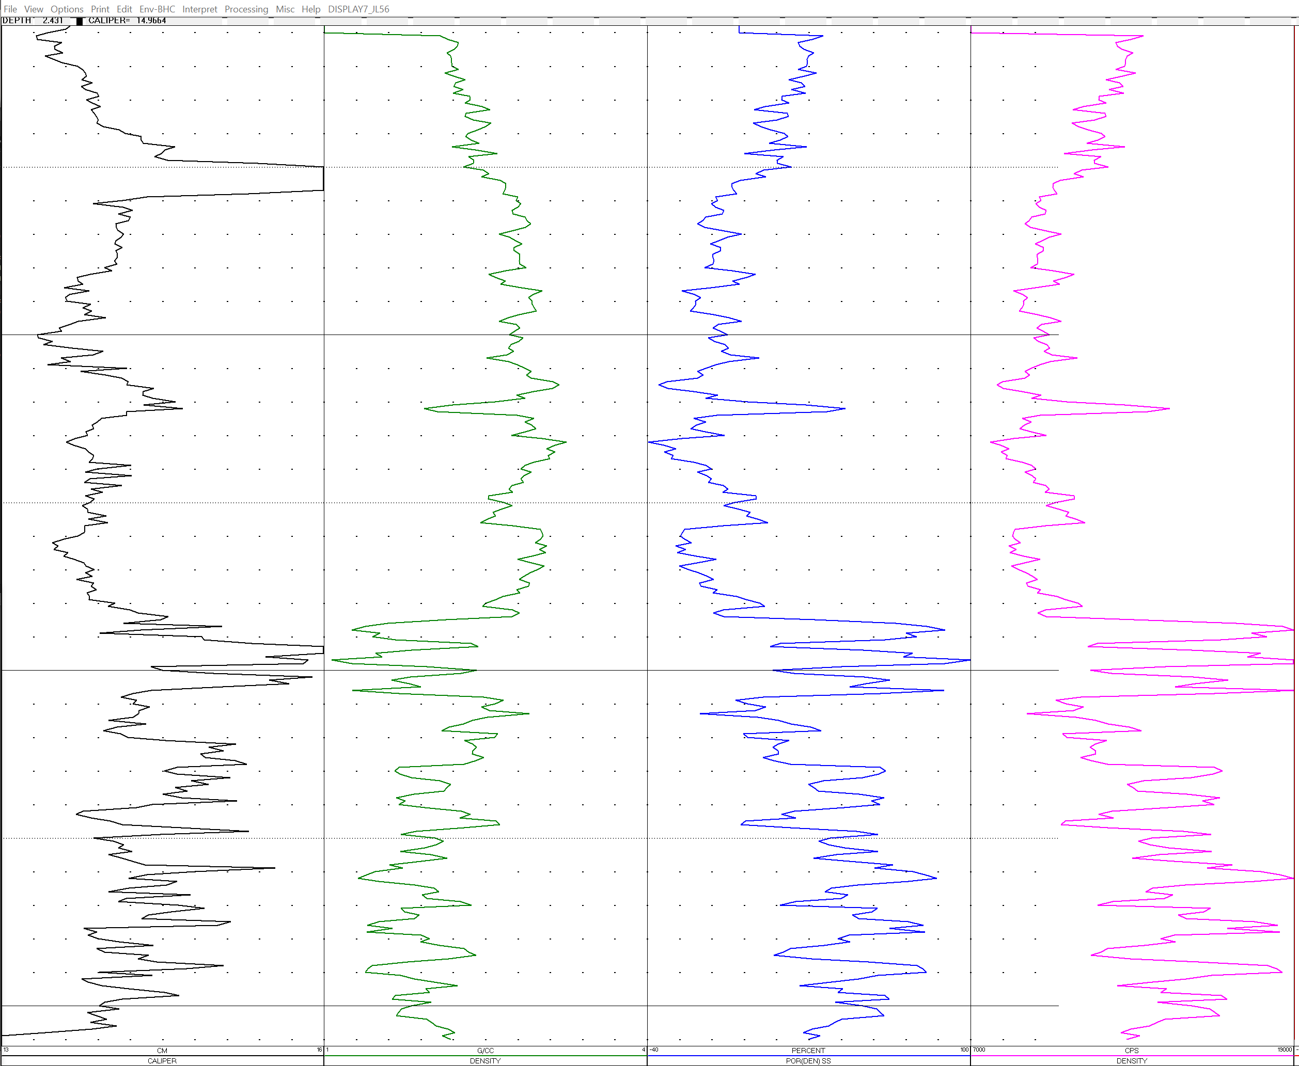


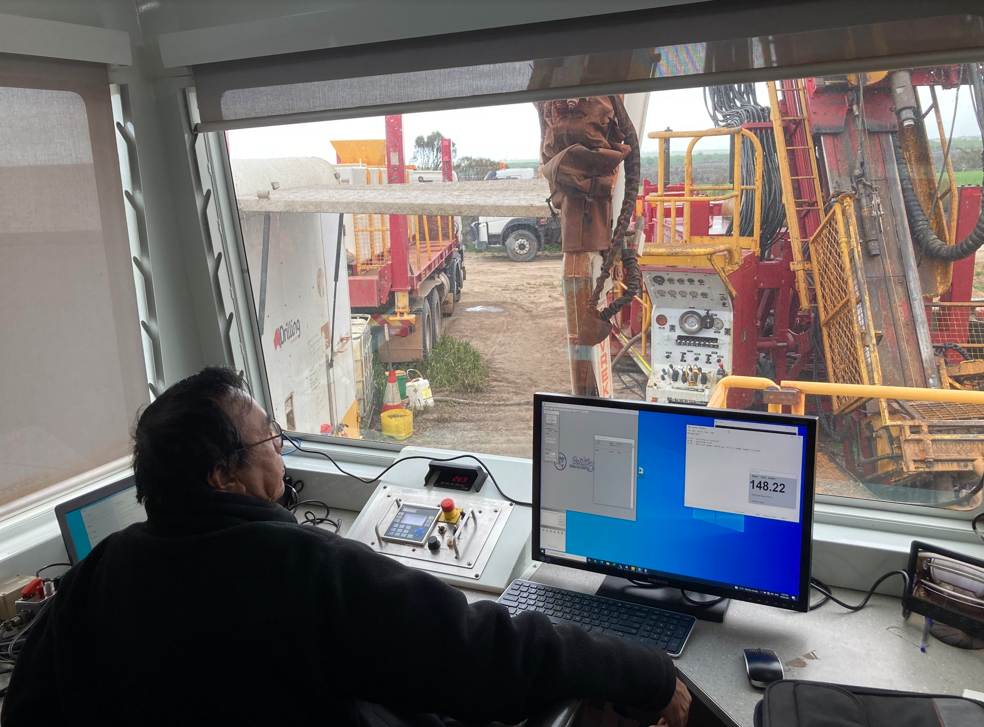

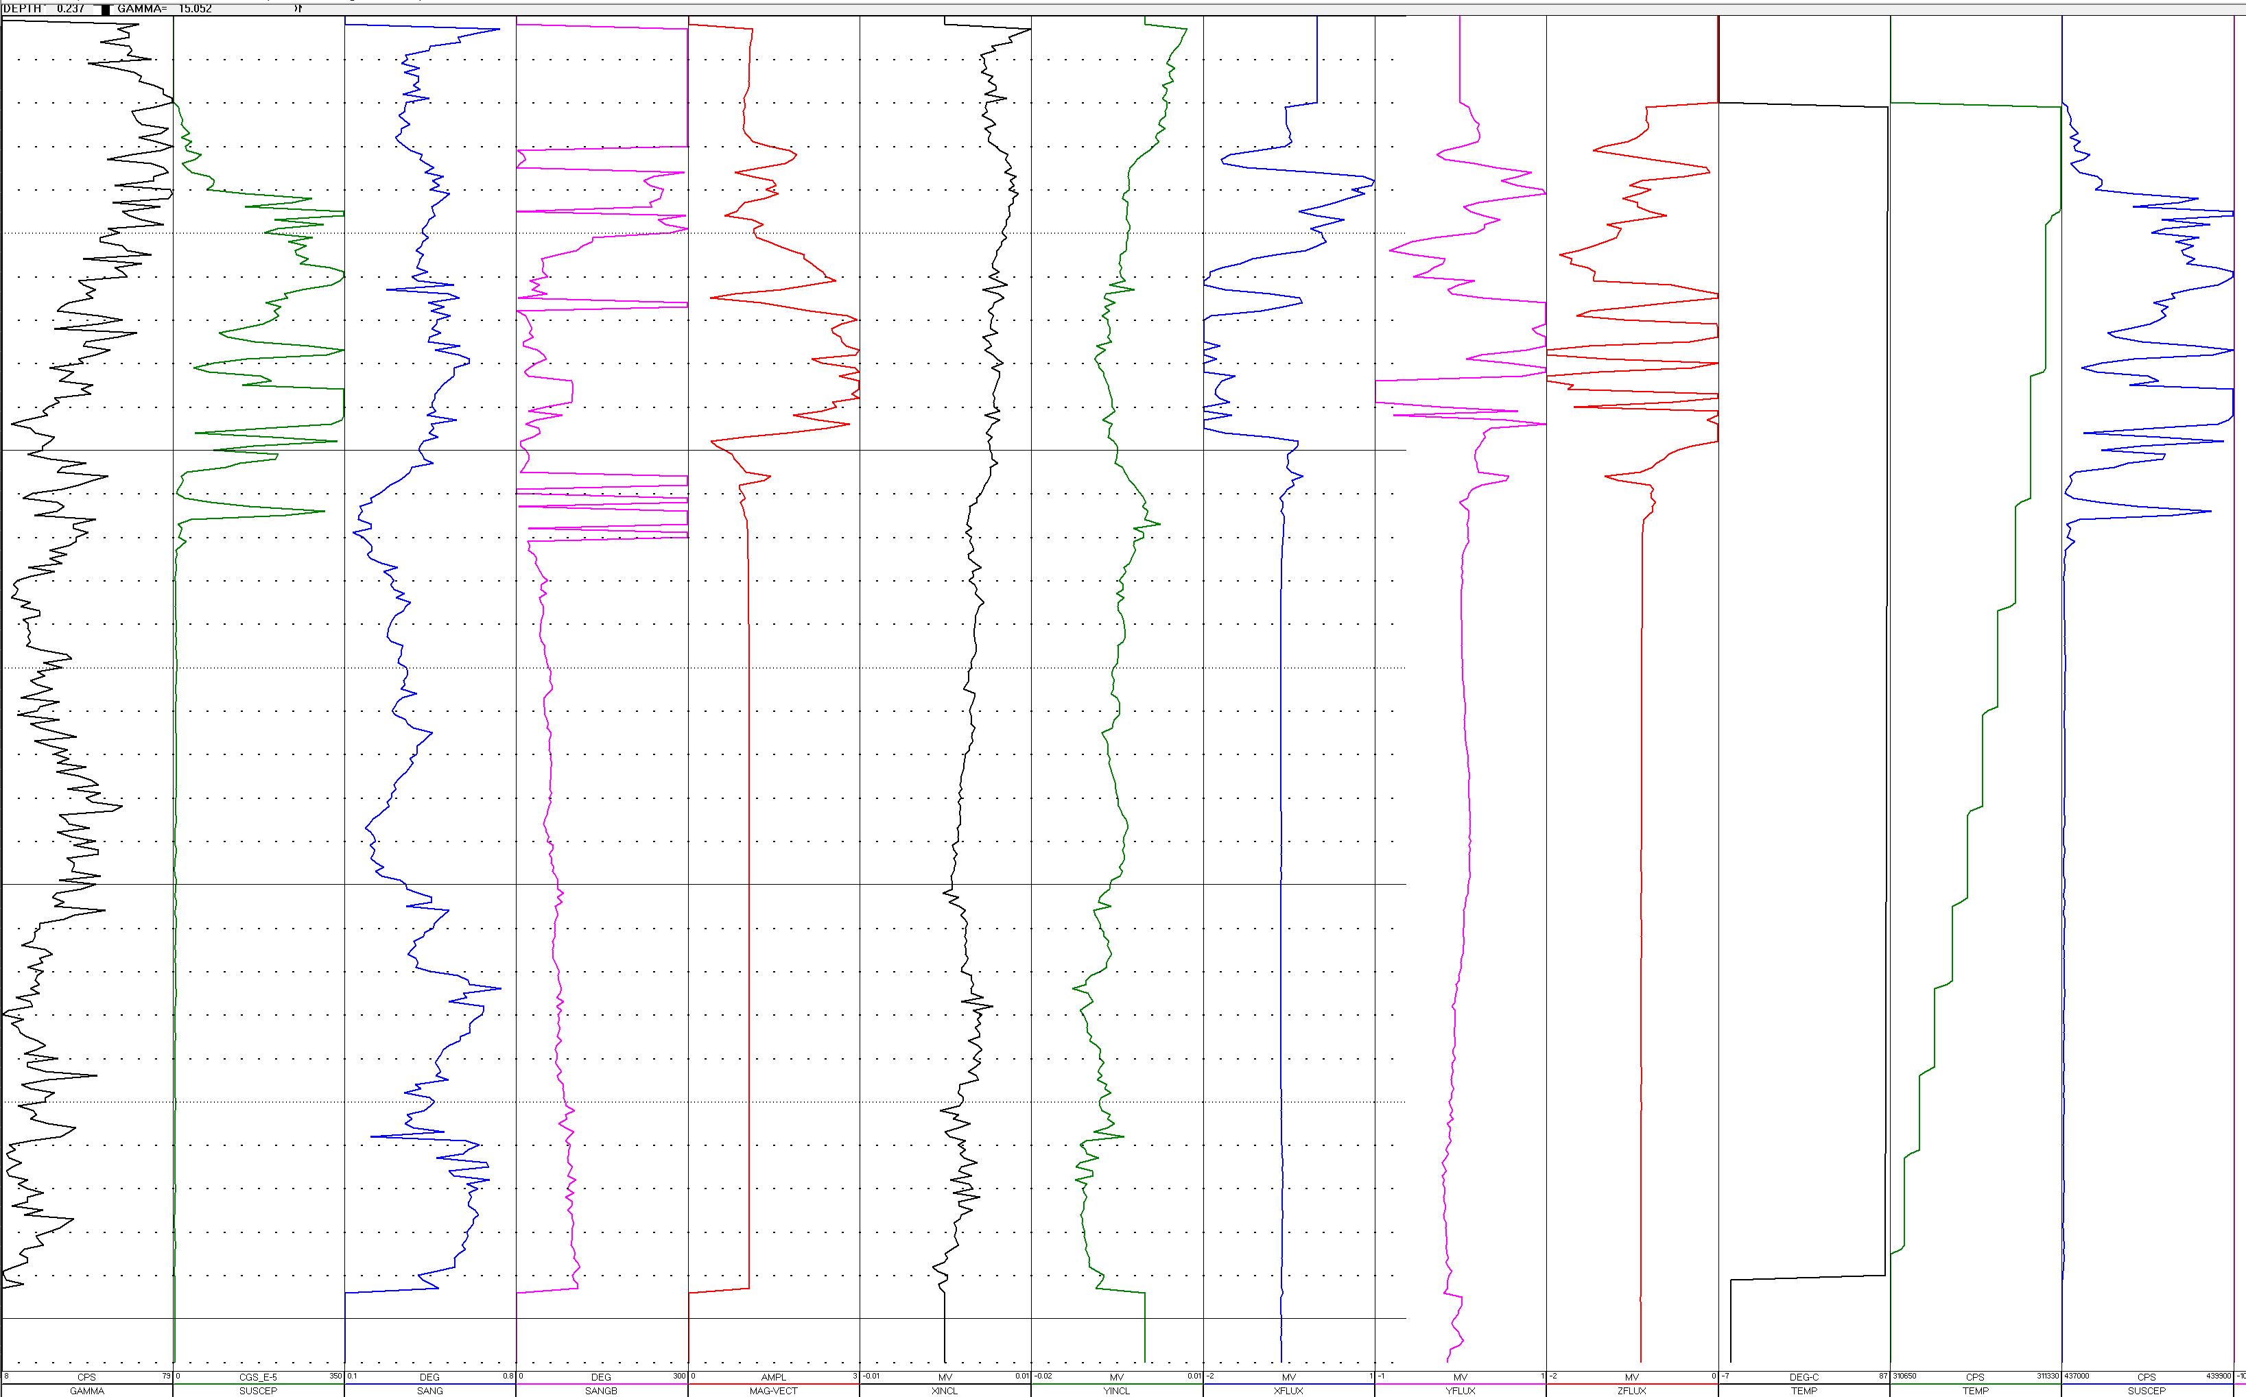






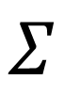
Gathering data
Formation Magnetic Susceptibility and Density measurements from almost 7000 holes were used.
Data was consolidated by tool type
Tool channels were analysed to create a model to perform clustering
1
2
$$Σ$$
SQL
3
…
n
CSV

Slide 8
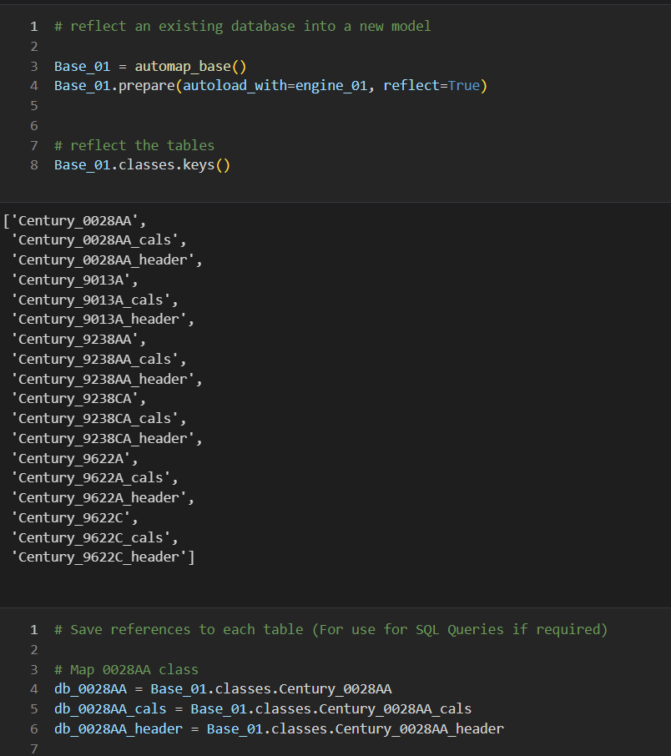
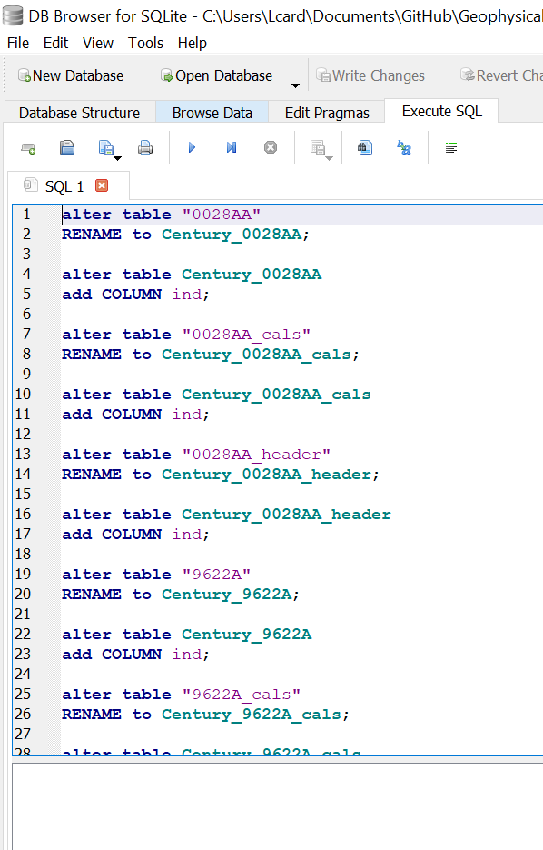
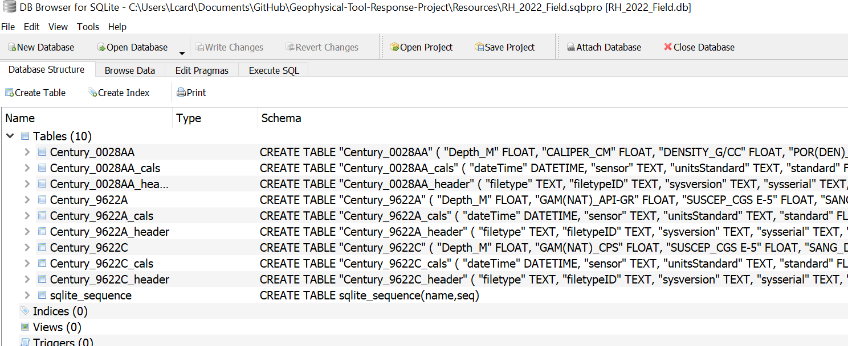
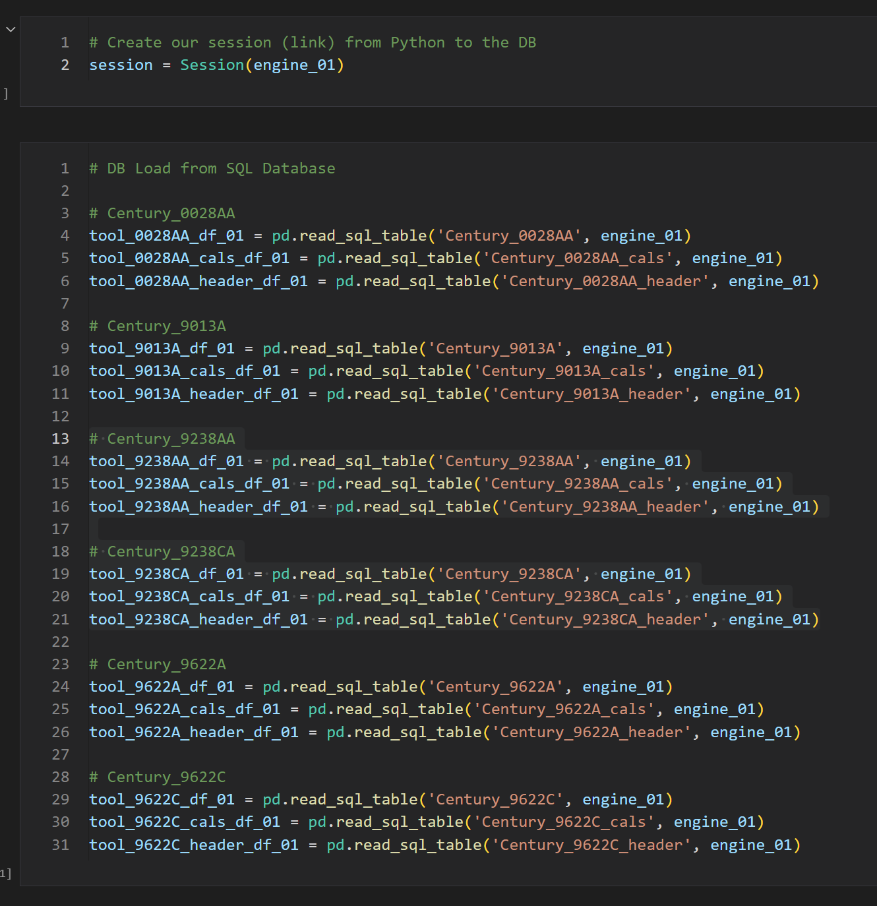
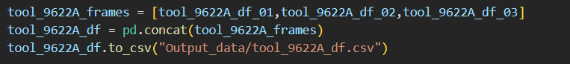
Creation of SQL Lite database and data loading
SQLite Datasets from different Fields altered to be read with SQL Alchemy
Auto-Incrementing Indexes and Primary Keys created
Concatenated and consolidated information in CSV files

Slide 9
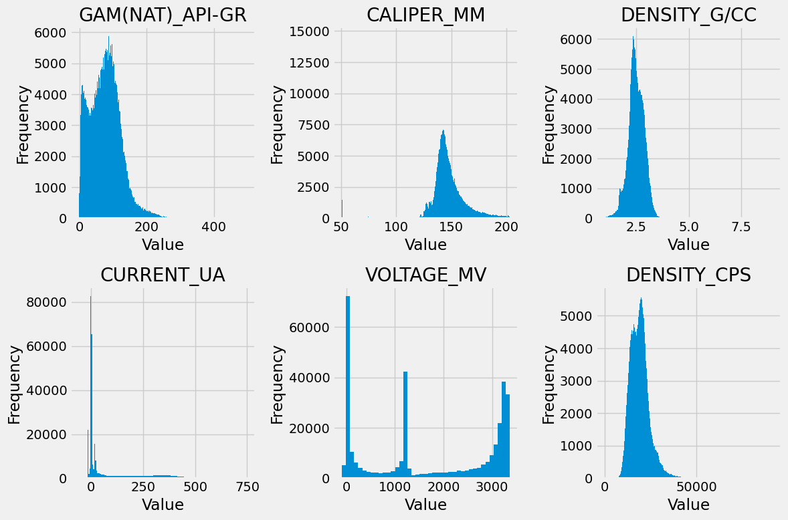
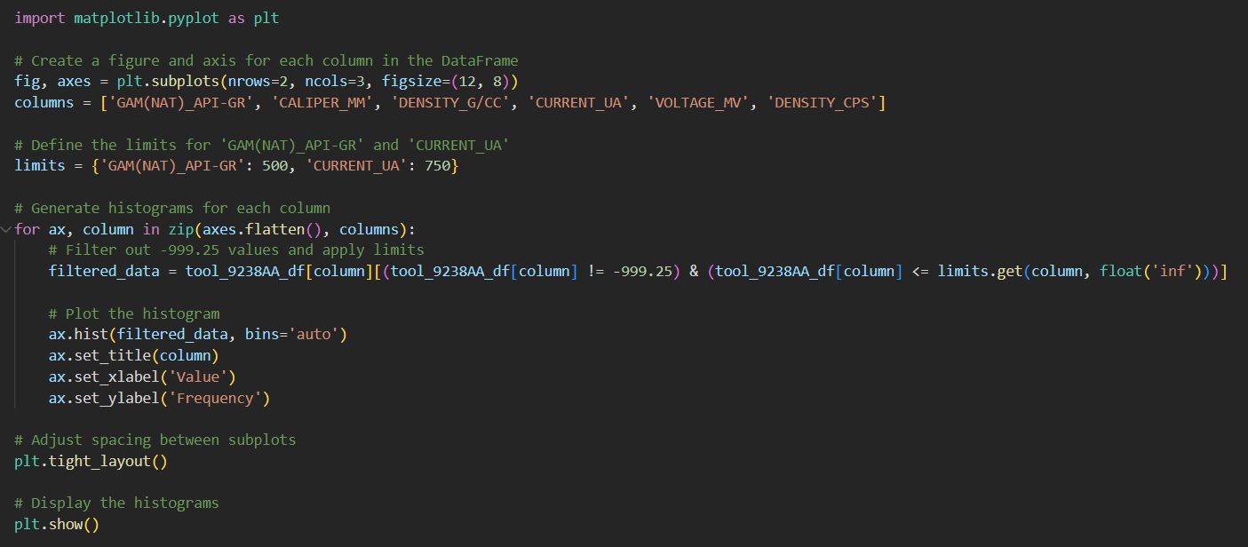
Analysing data
Channels used for modelling:
Magsus Tool - 'SUSCEP_CGS E-5’
Magsus Tool- 'GAM(NAT)_CPS’
Density Tool- 'DENSITY_G/CC’
Data visualisation required to understand tool response and to determine a model to be used
To help the operators we need to understand the data first!
Notes:
https://math.stackexchange.com/questions/4045242/averaging-over-mahalanobis-distance-vectors-of-different-clusters
https://towardsdatascience.com/machine-learning-for-anomaly-detection-elliptic-envelope-2c90528df0a6

Slide 10
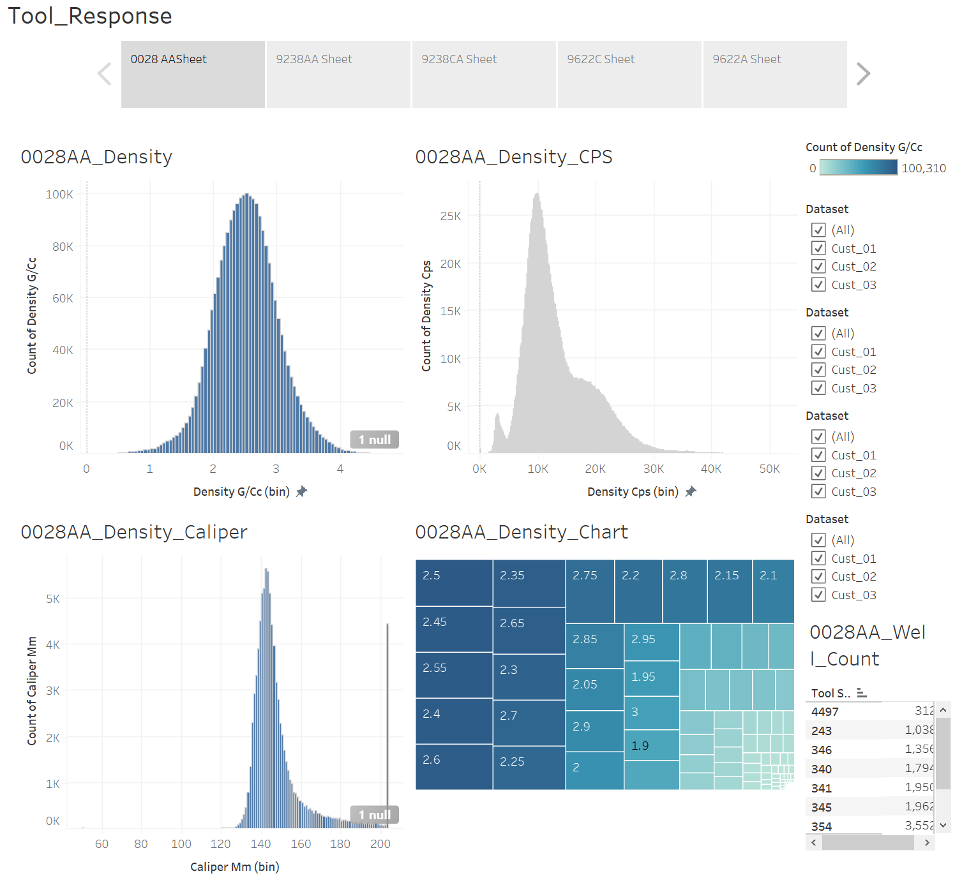
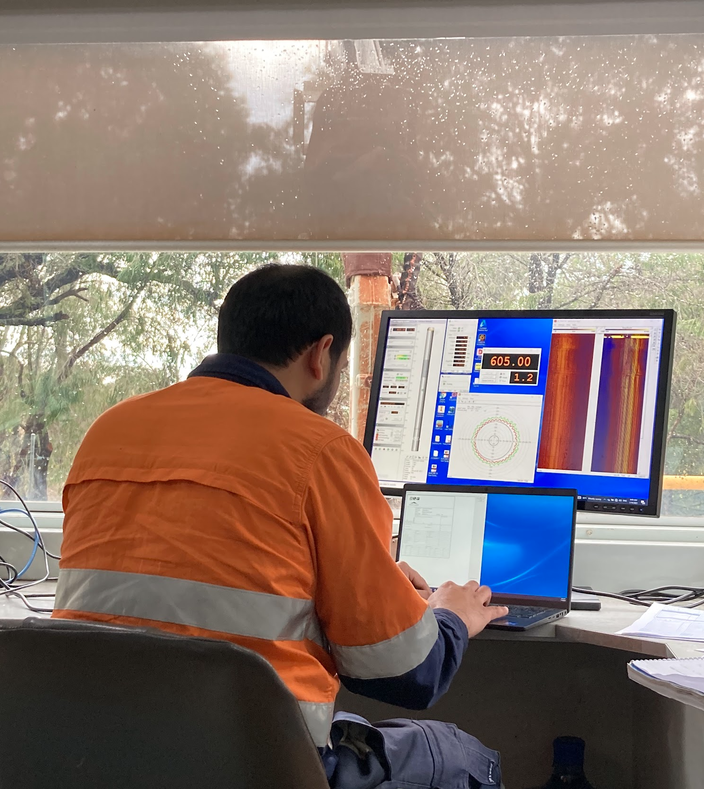
Data analysis /First operator aid
Operators run tools
Lines coming up: Good or bad?
Interactive Tableau dashboard created to guide on expected tool responses
Guide for data cleaning for ML
Notes:
In one location, more than one product line can be present. For this reason a drill down visualization was added to check to see whether there were differences between product lines. This chart also presents the data for the 3 types of compliance.

Slide 11
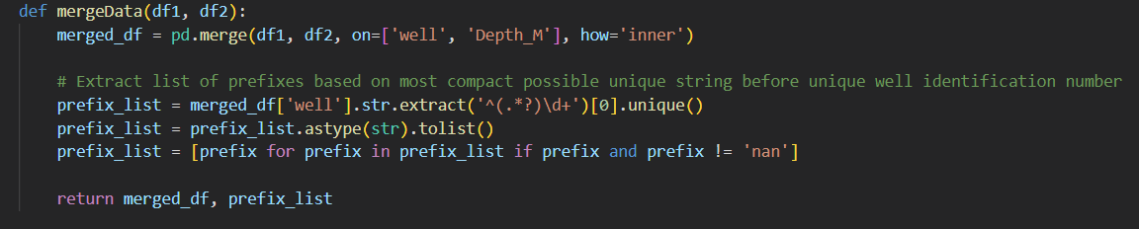
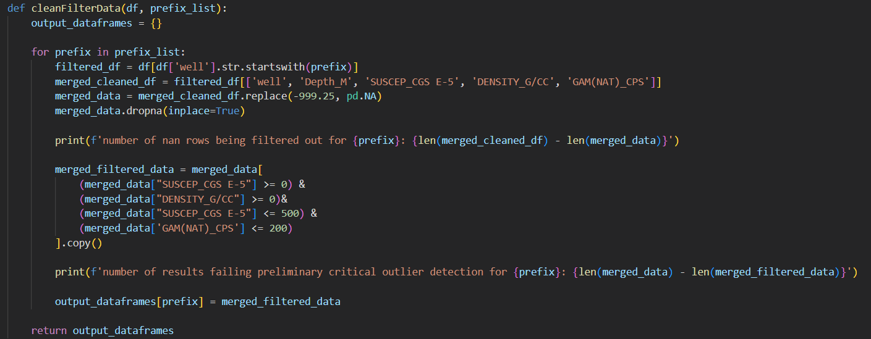
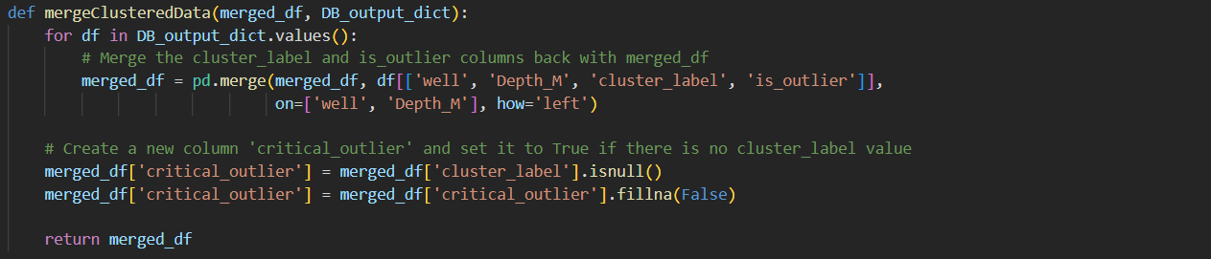
Cleaning DATA
Merged the dataset for Magsus and Density
Hole with matching (‘well’ and ‘Depth_M’)
Removed “999.25” Values
Industry standard for N/A values in tool logging
Removed values that are not feasible
Negative Susceptibility or Density values
Values outside the general stats obtained from the analysis of the available data

Slide 12
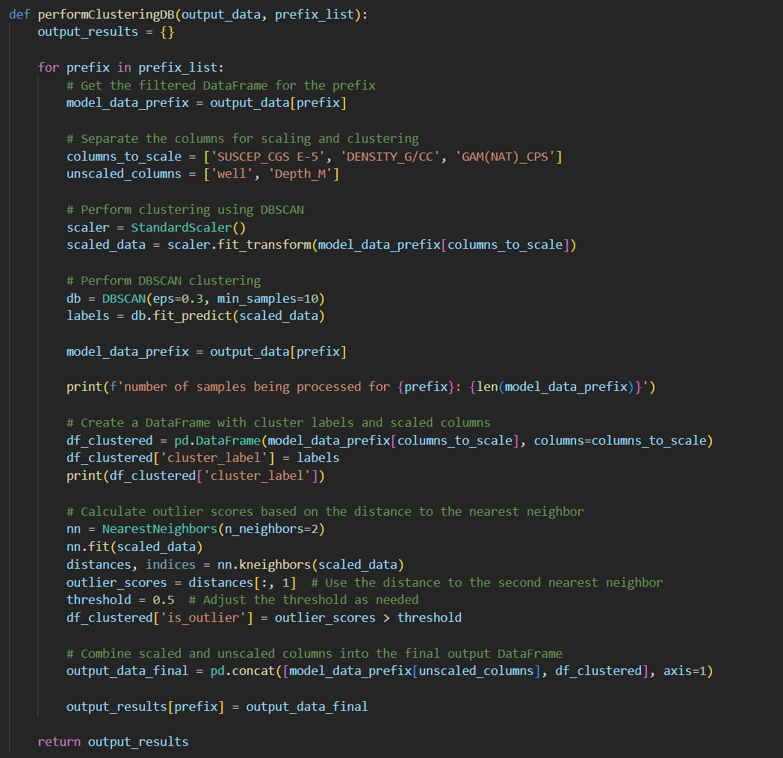
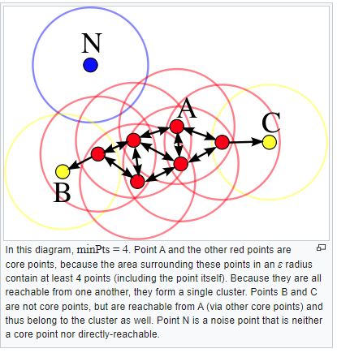
Clustering data – DBSCAN
The DBSCAN algorithm can be abstracted into the following steps:
Find the points in the ε neighborhood of every point, and identify the core points with more than minPts neighbors.
Find the connected components of core points on the neighbor graph, ignoring all non-core points.
Assign each non-core point to a nearby cluster if the cluster is an ε (eps) neighbor, otherwise assign it to noise.
Clustered data by hole prefix (hole geography)
Notes:
https://en.wikipedia.org/wiki/DBSCAN

Slide 13
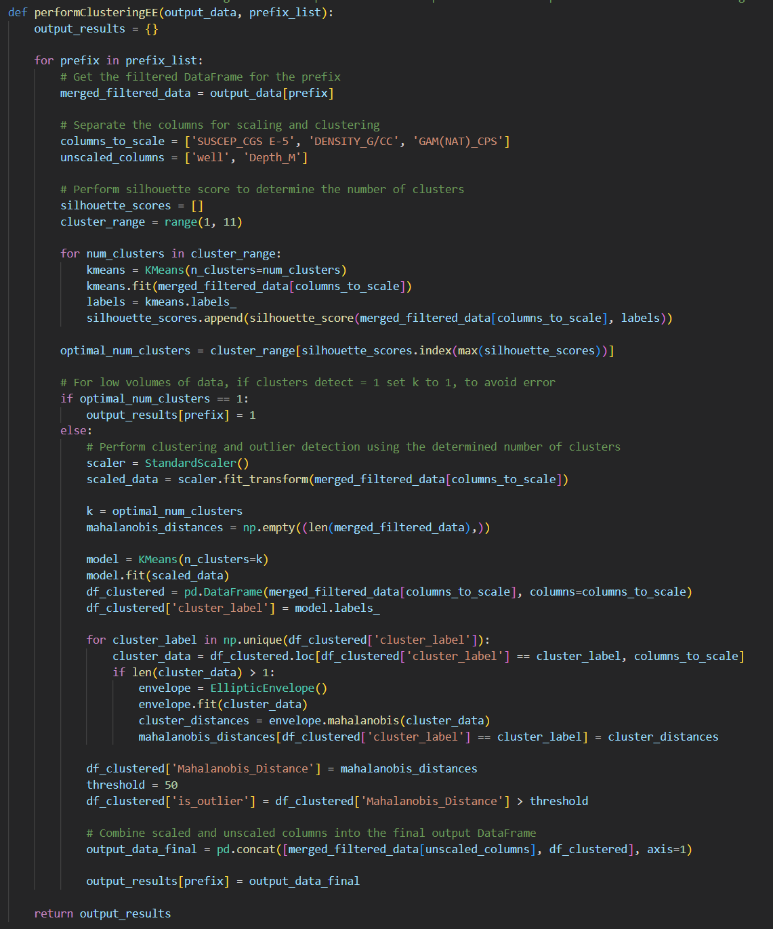
Clustering data
Clustering using other methods attempted
Notes:
https://math.stackexchange.com/questions/4045242/averaging-over-mahalanobis-distance-vectors-of-different-clusters
https://towardsdatascience.com/machine-learning-for-anomaly-detection-elliptic-envelope-2c90528df0a6

Slide 14
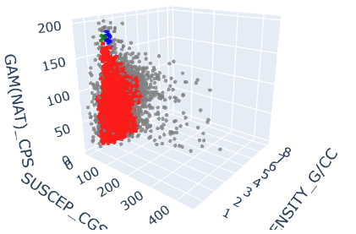
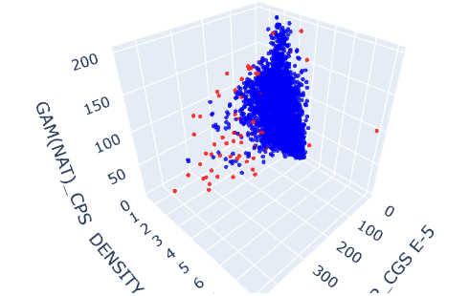
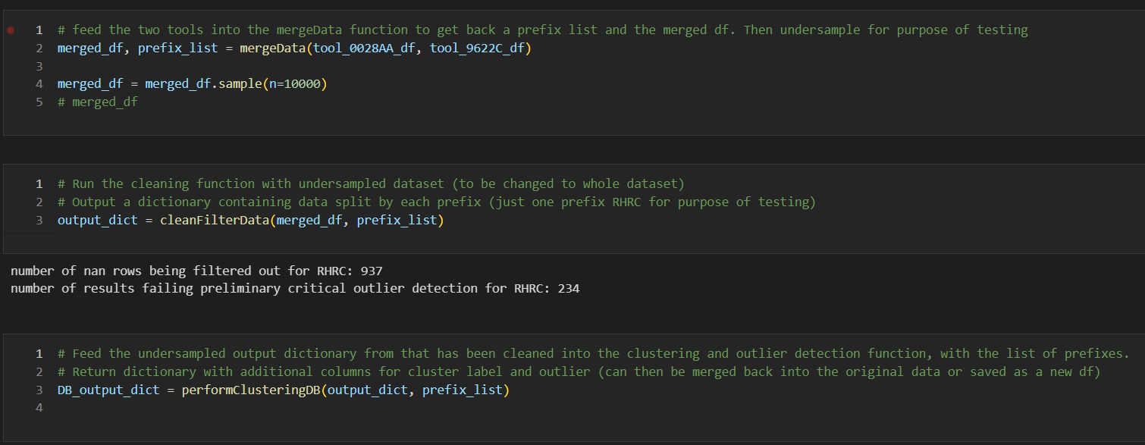
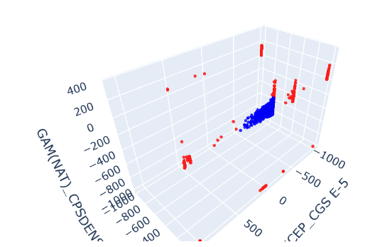
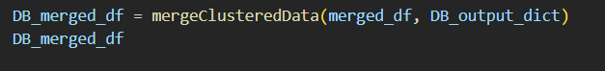
Clustering REsults
Other clustering algorithms were used, but the best results were obtained with DBScan.
Notes:
The variables that were selected to understand the behaviour where the R/A Measuement equipment Calibration Records, R/A Source Leak Test Records and Photo inventories. The data was queried from the SQLite database and sent via JSON through an Flask API. JavaScript was then used to handle the data to match the requirements of the libraries used for visualization.
For the project Highcharts JS and Leaflet Libraries were used for the visualizations.

Slide 15
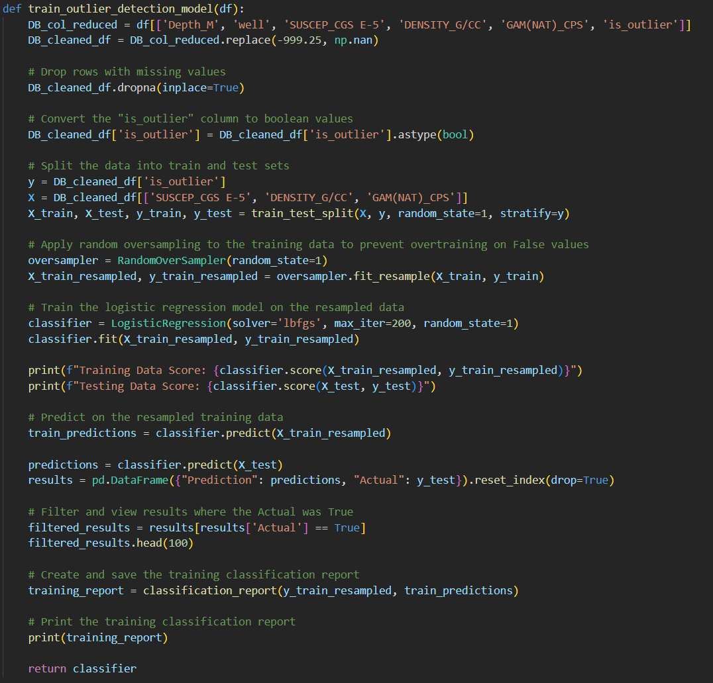
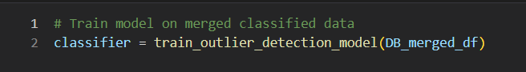
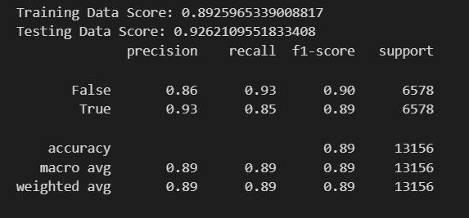
Machine learning REsults
Notes:
The variables that were selected to understand the behaviour where the R/A Measuement equipment Calibration Records, R/A Source Leak Test Records and Photo inventories. The data was queried from the SQLite database and sent via JSON through an Flask API. JavaScript was then used to handle the data to match the requirements of the libraries used for visualization.
For the project Highcharts JS and Leaflet Libraries were used for the visualizations.

Slide 16
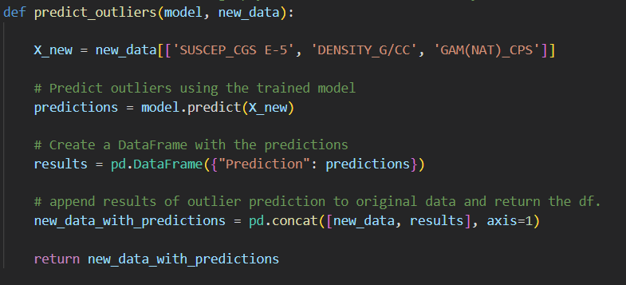
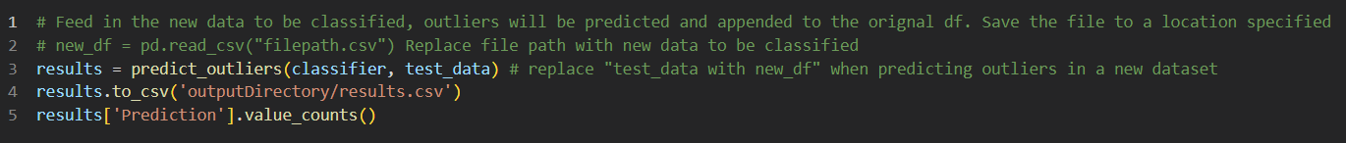
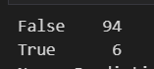
Machine learning REsults
Notes:
The variables that were selected to understand the behaviour where the R/A Measuement equipment Calibration Records, R/A Source Leak Test Records and Photo inventories. The data was queried from the SQLite database and sent via JSON through an Flask API. JavaScript was then used to handle the data to match the requirements of the libraries used for visualization.
For the project Highcharts JS and Leaflet Libraries were used for the visualizations.

Slide 17
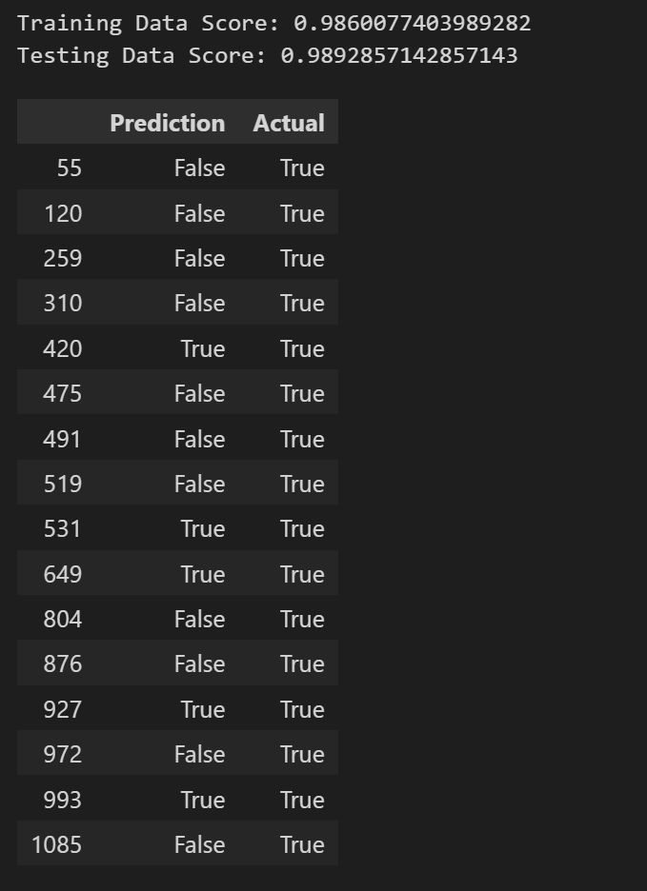
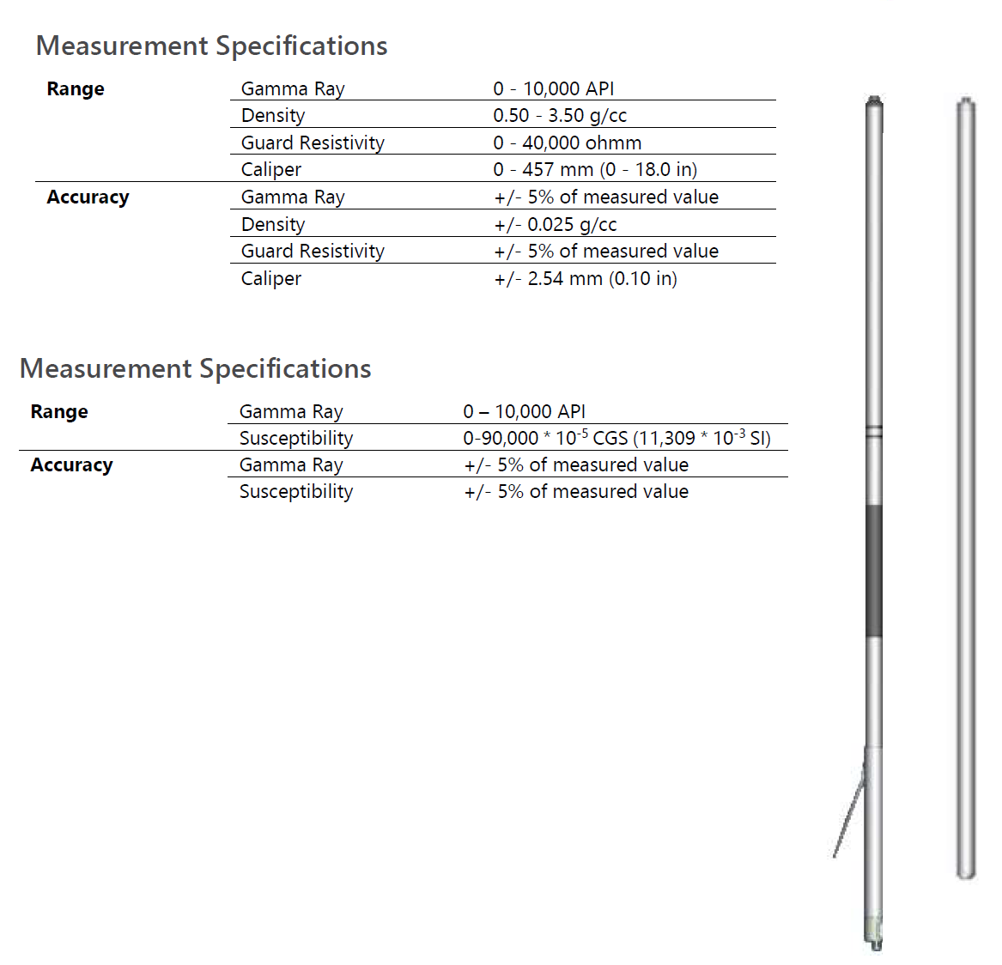
Deciding criteria
Information to decide
Percentage of outliers per hole as compared to the model < 5% OK
Tool outside spec – Not OK
Hardware Fault – No Curve change – Not OK
Percentage of outliers > 5% up to 15% - Be cautious for next hole
Percentage of outliers > 15 % Warning: Call town
Notes:
For the 3 types compliance, equipment was registered as Compliant, Action needed (where the time to expire is within a month), Critical ( within a week) or Non compliant. One of the visualizations plotted the compliance by location.

Slide 18
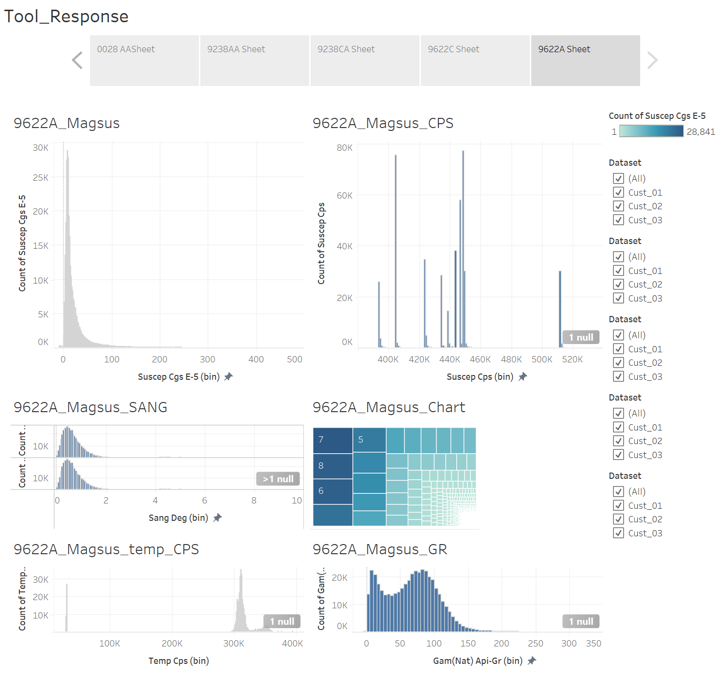
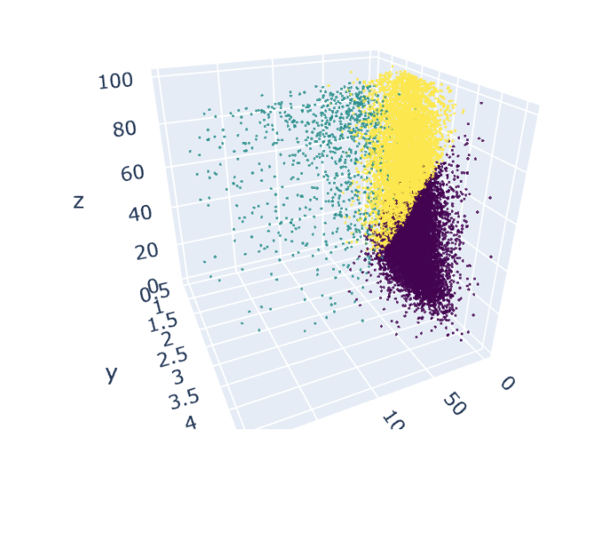
Final remarks
Tools to help an operator that is not experienced were developed including an Interactive Visualization for the tools with Real Data that can show the user how variables interact
A Clustering algorithm was successfully created merging geophysical variables Gamma Ray, Magsus and Density
Visuals from the clustering give a powerful explanation of what is happening based on real data
A logistic regression model was developed, which can provide the user confidence on the acquired data

Slide 19
SUMMARY
A problem worth solving, analyzing, or visualizing was found
Machine learning with the technologies we’ve learned was used to solve the problem
Scikit-learn and/or another machine learning library was used.
Python Pandas, Tableau and SQL were used among others

Slide 20

Project requirements
Based on Project Requirements
Key objective* Metrics
 | Data Model | GitHub | Presentation
A Python script initialises, trains, and evaluates a mode
SQLite Database
The data handled prior to modelling
The model predictive power at least 75%
Model outputs to CSV File
Performance displayed
Files and Readme available
User Driven interactions
Presentation
* Other metrics are subjective – Digestible, easy to interpret, and presentation aspects

Slide 21
THANK YOU
Luis E. Cardenas​
LCardSVR@gmail.com
https://github.com/LCardSVR
Joshua Bell
Josh.Marc.Bell@hotmail.com
https://github.com/JoshMBell

